Slide 1
Decision Trees

Slide 2



Decision Tree
A decision tree organizes information into groups and subgroups so that decisions may be made about objects according to which group and sub-group they belong to, based on the information we receive about them
Given dataset D={x₁,x₂,…,x_{n}}
Where x1 ={f₁,f₂,…,f_{d}},classes{c₁,c₂,,,,,c_{c}}
DT is a tree with:
Nodes representing attributes
Arcs are possible values for the attributes
Each leaf node assigns a classification label
Popular technique for classification;
Leaf node indicates class to which the corresponding tuple

Slide 3
Decision Tree

Slide 4
Decision Tree

Slide 5
Decision Tree
Level | Lang | Tweets | PhD | Interview
Senior | Java | No | No | F
Senior | Java | No | Yes | F
Mid | Python | No | No | T
Junior | Python | No | No | T
Junior | R | Yes | No | T
Junior | R | Yes | Yes | F
Mid | R | Yes | Yes | T
Senior | Python | No | No | F
Senior | R | Yes | No | T
Junior | Python | Yes | No | T
Senior | Python | Yes | Yes | T
Mid | Python | No | Yes | T
Mid | Java | Yes | No | T
Junior | Python | No | Yes | F

Slide 6
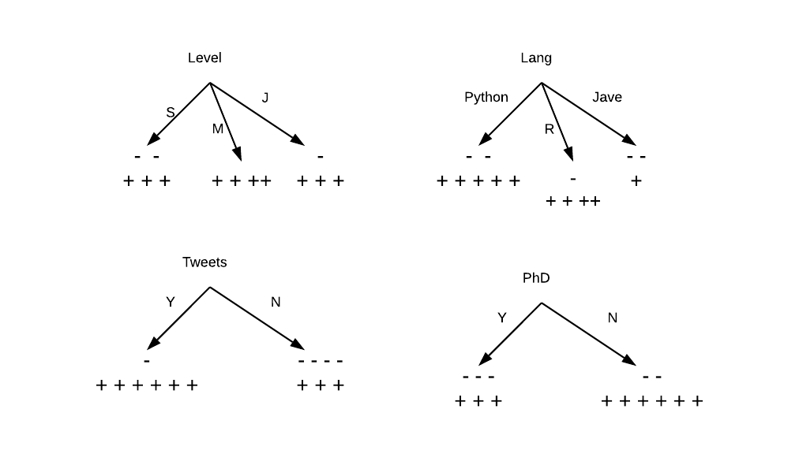
Decision Tree

Slide 7
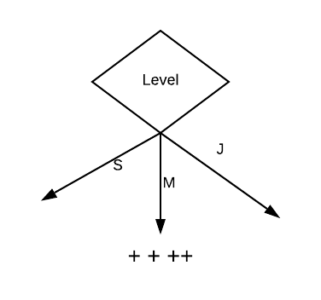
Decision Tree

Slide 8
Decision Tree
Level | Lang | Tweets | PhD | Interview
Senior | Java | No | No | F
Senior | Java | No | Yes | F
Mid | Python | No | No | T
Junior | Python | No | No | T
Junior | R | Yes | No | T
Junior | R | Yes | Yes | F
Mid | R | Yes | Yes | T
Senior | Python | No | No | F
Senior | R | Yes | No | T
Junior | Python | Yes | No | T
Senior | Python | Yes | Yes | T
Mid | Python | No | Yes | T
Mid | Java | Yes | No | T
Junior | Python | No | Yes | F

Slide 9
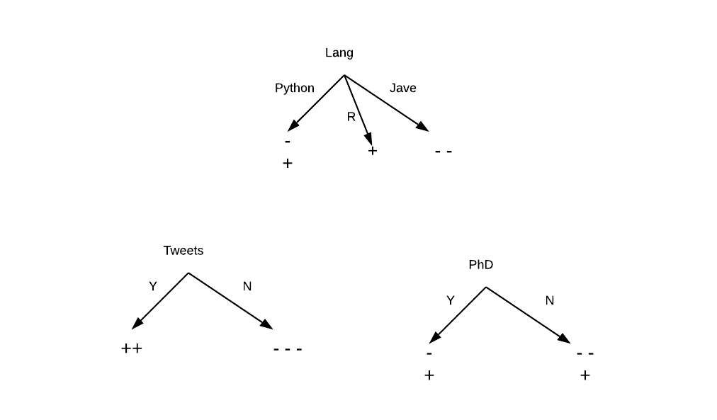
Decision Tree

Slide 10
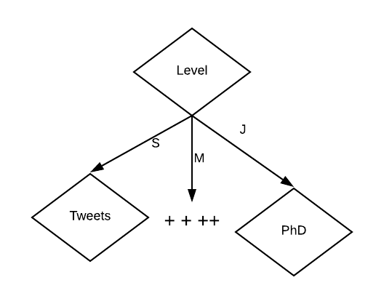
Decision Tree

Slide 11
Issues
Choosing the splitting attribute (use information gain)
The order is important (2nd test on height in (b) not efficient)
Number of splits (successors) not simple for continuous data
Tree structure: better to have balanced with small # of levels
Pruning, stopping the tree to achieve generalization

Slide 12
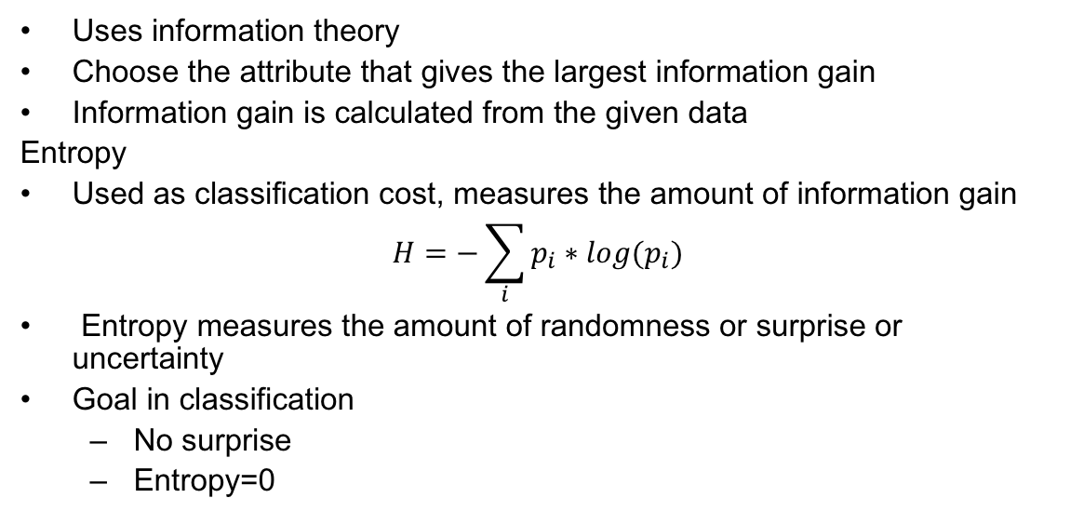
ID3
Uses information theory
Choose the attribute that gives the largest information gain
Information gain is calculated from the given data
Entropy
Used as classification cost, measures the amount of information gain
$$H=−\sum_{i}{p_{i}∗log(p_{i})}$$
Entropy measures the amount of randomness or surprise or uncertainty
Goal in classification
No surprise
Entropy=0

Slide 13
ID3
Creates tree using information theory concepts and tries to reduce expected number of comparison
ID3 chooses split attribute with the highest information gain

Slide 14
ID3: Issues
It is a greedy algorithm that makes a decision at each node of the tree regarding which attribute to use to split the data at the next node, based on which “minimizes information entropy
It does not take into account what might happen in subsequent steps, thus it is “greedy”

Slide 15
C4.5 - WEKA
ID3 favors attributes with large number of divisions
C4.5 improved version of ID3: ▪ Handles:
Missing Data
Continuous Data
Pruning
Rules
GainRatio:

Slide 16
C5 - Windows
Commercial version of C4.5
Speed - C5.0 is significantly faster than C4.5 (several orders of magnitude)
Memory usage - C5.0 is more memory efficient than C4.5
Smaller decision trees.
It has boosting

Slide 17
Classification And Regression Trees - Python
Decision Tree algorithms that can be used for classification or regression predictive modeling problems.
Classification and regression trees (CART) are a decision tree learning technique that produces either classification or regression trees
They are binary trees.
Uses “Gini Impurity” for splitting
Gini Impurity measures the disorder of a set of elements. It is calculated as the probability of mislabelling an element assuming that the element is randomly labelled according the the distribution of all the classes in the set.
Decision trees in python use CART with either entropy or Gini as a splitting criterion.

Slide 18
DT Advantages/Disadvantages
Advantages
Easy to understand.
Easy to generate rules
Disadvantage
May suffer from overfitting.
Classifies by rectangular partitioning.
Does not easily handle nonnumeric data.
Can be quite large – pruning is necessary.

